Slide 1
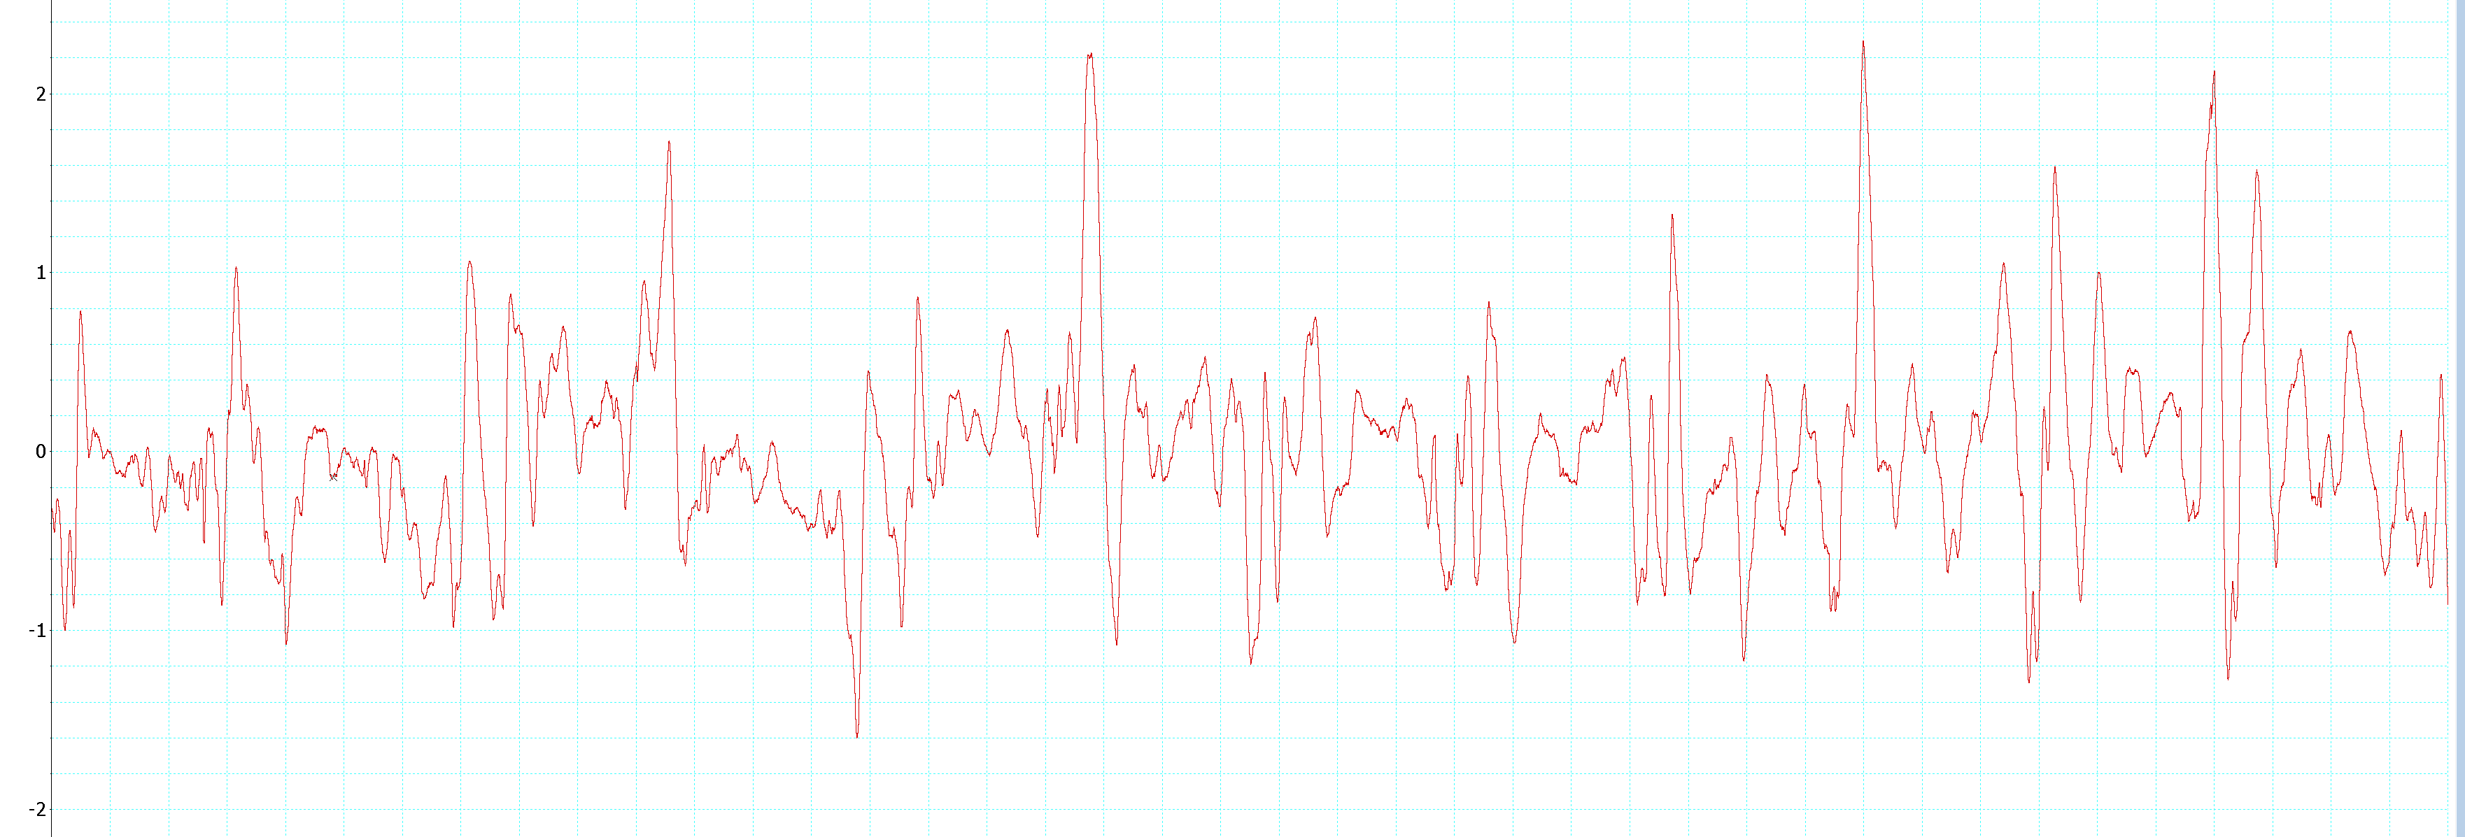
Normal Flight Pattern EMG of Cockroach Anterior Left Wing
Voltage (V)
51.8 51.9 52.0
Time (s)
Figure 1a – Anterior Left Wing
This recording depicts the beating of the anterior left wing during the cockroach’s flight. Spikes recorded with voltages above 1.0V were selected as points of interest; whereas anything below is likely noise. There are eight spikes over 0.2 seconds.

Slide 2
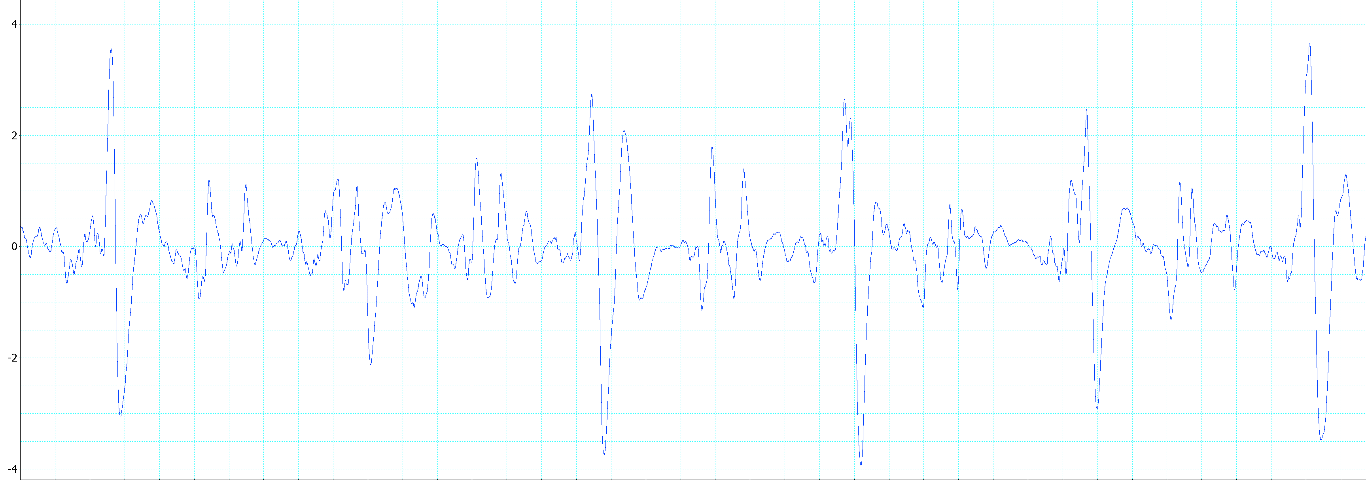
Normal Flight Pattern EMG of Cockroach Anterior Right Wing
Voltage (V)
51.8 51.9 52.0
Time (s)
Figure 1b – Anterior Right Wing
This recording depicts the beating of the anterior right wing during the cockroach’s flight. Spikes recorded with voltages above 1.5V were selected as points of interest; whereas anything below is likely noise. There are eight spikes over 0.2 seconds.

Slide 3
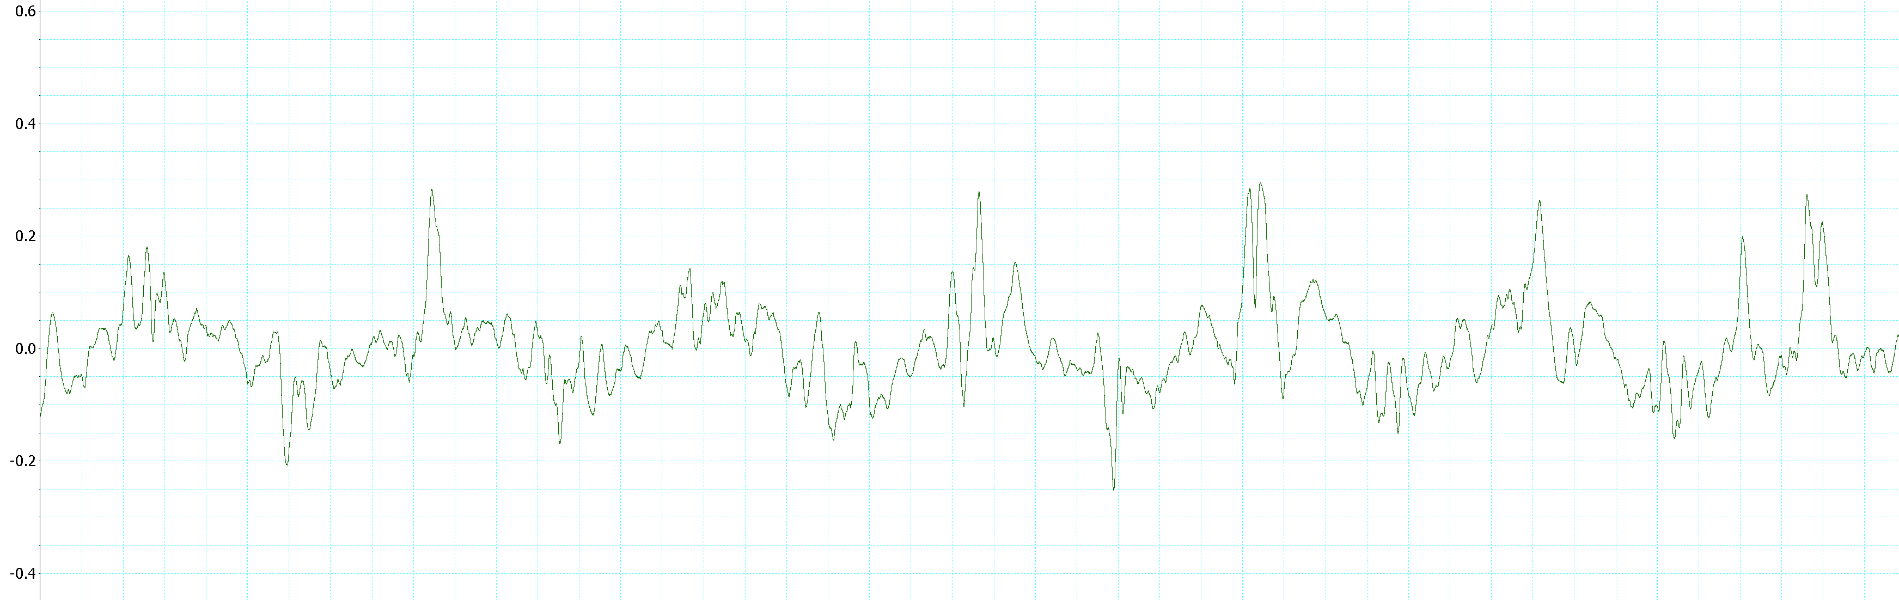
Normal Flight Pattern EMG of Cockroach Posterior Left Wing
Voltage (V)
51.8 51.9 52.0
Times (s)
Figure 1c – Posterior Left Wing
This recording depicts the beating of the posterior left wing during the cockroach’s flight. Spikes recorded with voltages above 0.2V were selected as points of interest; whereas anything below is likely noise. There are five spikes over 0.2 seconds.

Slide 4
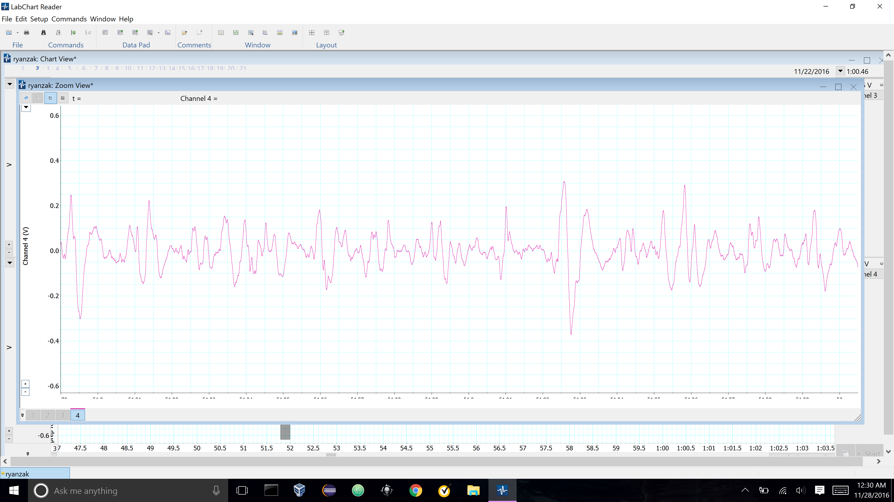
Normal Flight Pattern EMG of Cockroach Posterior Right Wing
Voltage (V)
51.8 51.9 52.0
Time (s)
Figure 1d – Posterior Right Wing
This recording depicts the beating of the posterior right wing during the cockroach’s flight. Spikes recorded with voltages above 0.15V were selected as points of interest; whereas anything below is likely noise. There are eight spikes over 0.2 seconds.

Slide 5
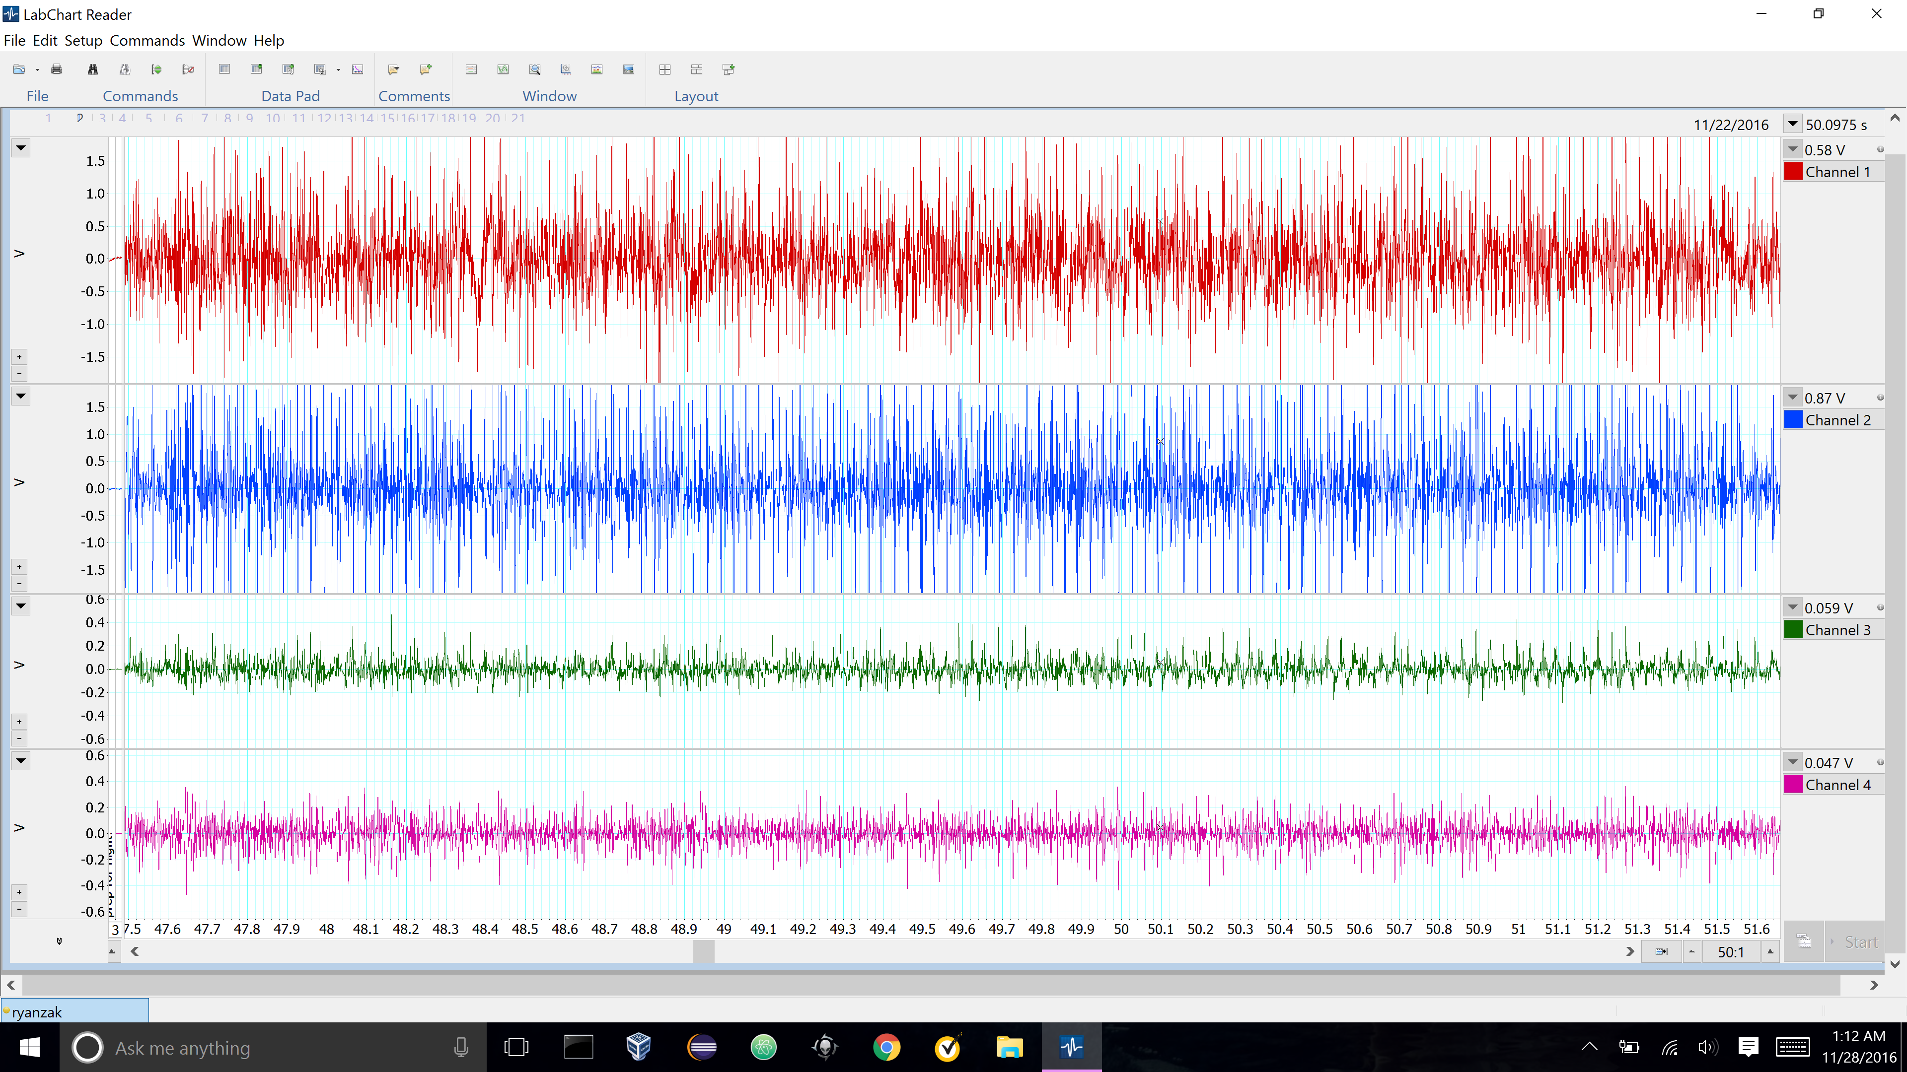
Normal Flight Pattern EMG of Cockroach
Time (s)
Figure 2a – Unhindered Cockroach Flight
The EMG recording above depicts the activity of all wings on the cockroach over the course of about 4 seconds without any applied hindrances (wind current was normally projected directly in front of the roach). The red EMG represents the anterior left wing, the blue represents the anterior right, the green represent posterior left wing, and the pink represents the posterior right wing.

Slide 6
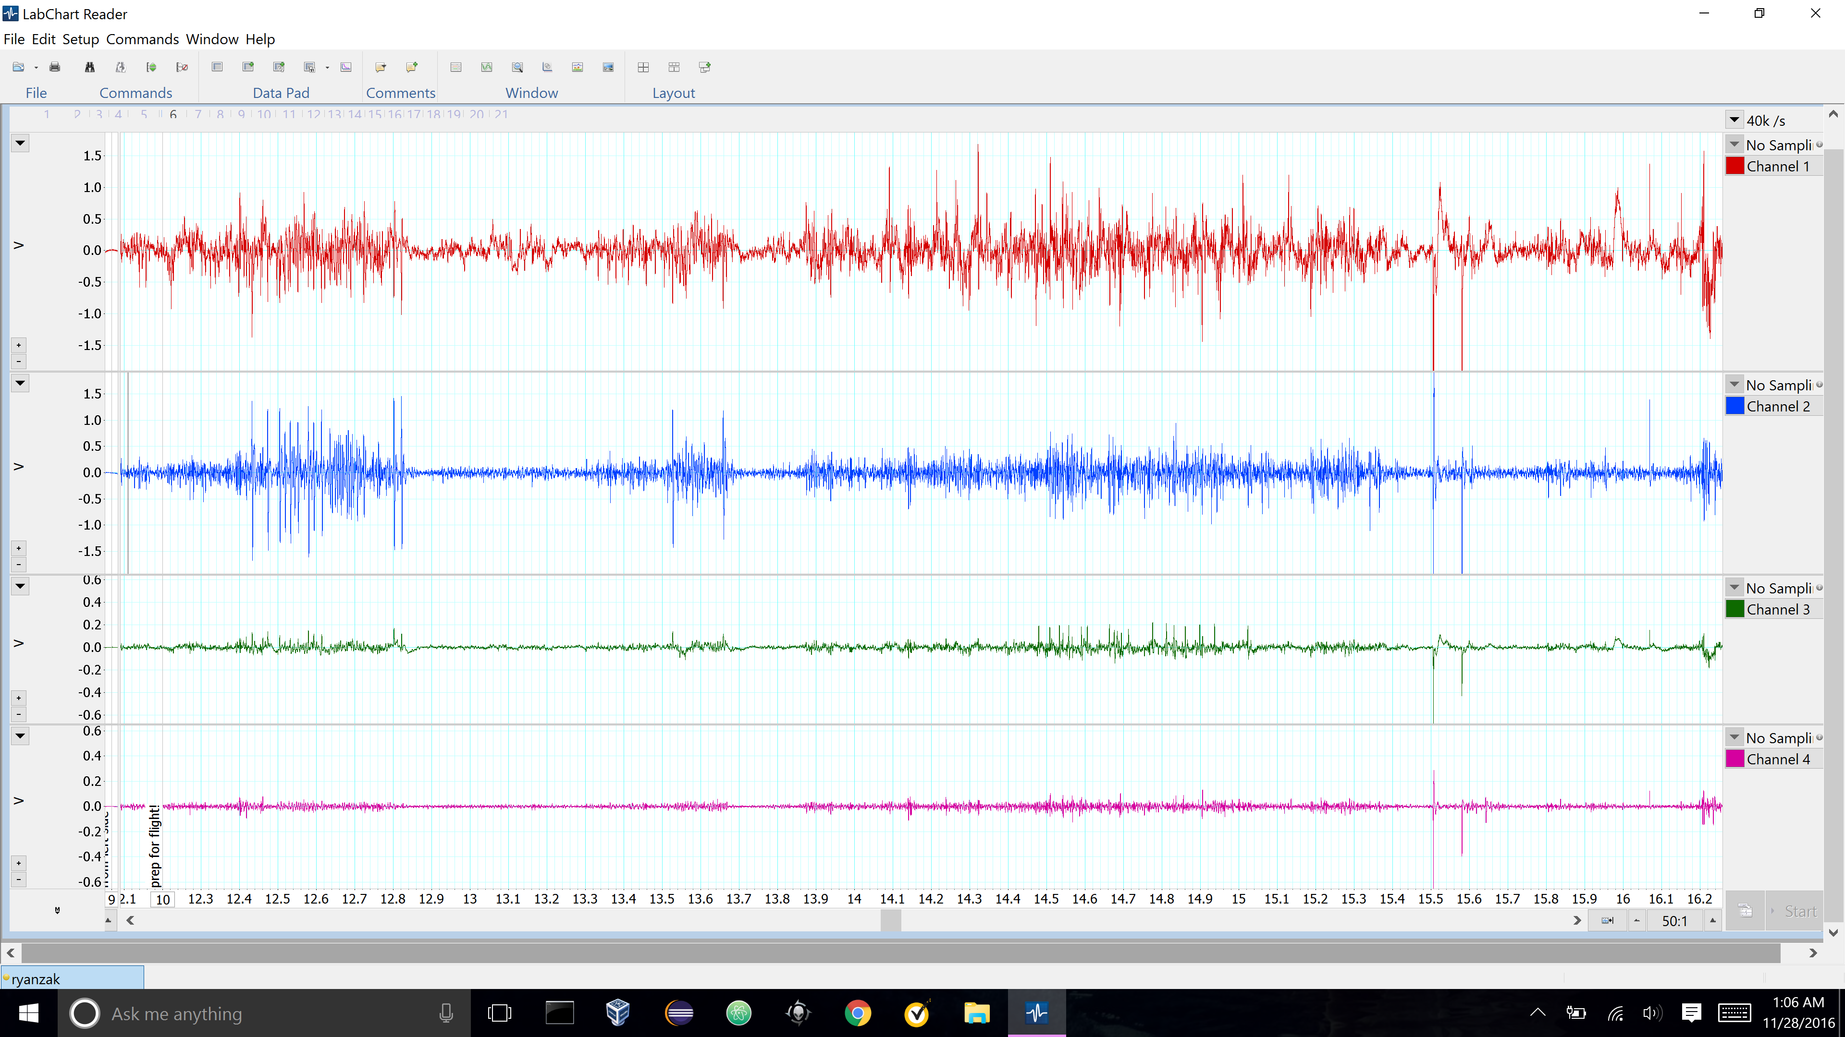
Flight Pattern During Applied Wind Current to Left Side of Cockroach
Time (s)
Figure 2b – Wind Applied to Left of Cockroach During Flight.
The EMG recording above depicts the activity of all wings on the cockroach over the course of about 4 seconds with an applied wind current to the left of the cockroach. The red EMG represents the anterior left wing, the blue represents the anterior right, the green represent posterior left wing, and the pink represents the posterior right wing. Highlighted in blue shows area of decreased or no activity.

Slide 7
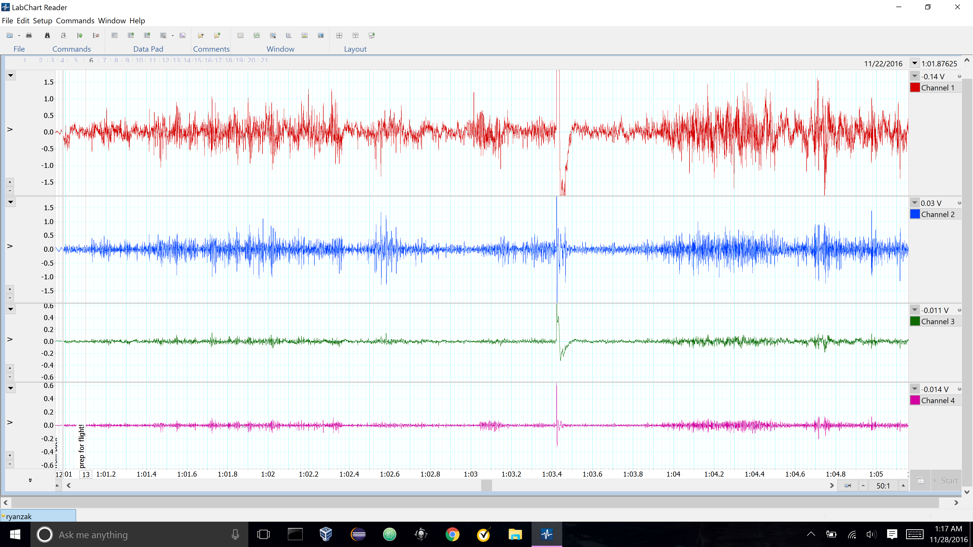
Flight Pattern During Applied Wind Current Behind Cockroach
Time (s)
Figure 2c – Wind Applied Behind Cockroach During Flight.
The EMG recording above depicts the activity of all wings on the cockroach over the course of about 4 seconds with a wind current applied behind the specimen. The red EMG represents the anterior left wing, the blue represents the anterior right, the green represent posterior left wing, and the pink represents the posterior right wing. Highlighted in blue shows area of decreased or no activity.

Slide 8
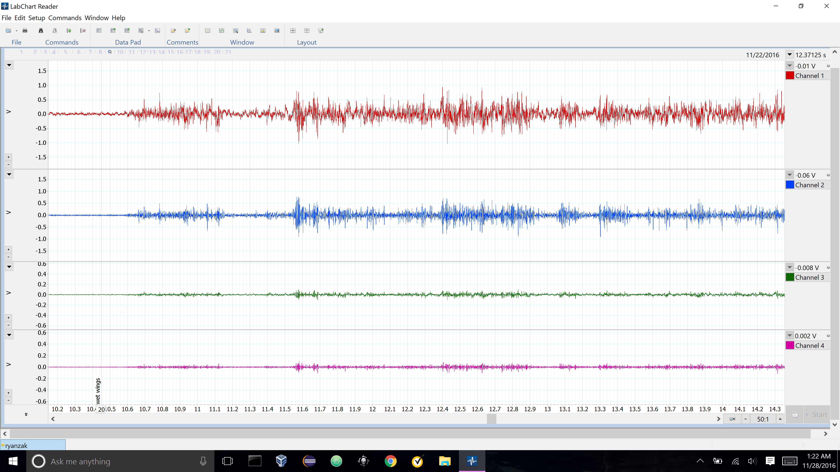
Flight Pattern After Application of Water Droplets to Anterior Left and Right Wings of Cockroach
Time (s)
Figure 2d – Water Droplets Applied to Cockroach Anterior Wings
The EMG recording above depicts the activity of all wings on the cockroach over the course of about 4 seconds with water applied to both left and right anterior wings of the roach. The red EMG represents the anterior left wing, the blue represents the anterior right, the green represent posterior left wing, and the pink represents the posterior right wing. Highlighted in blue shows area of decreased or no activity.

Slide 9
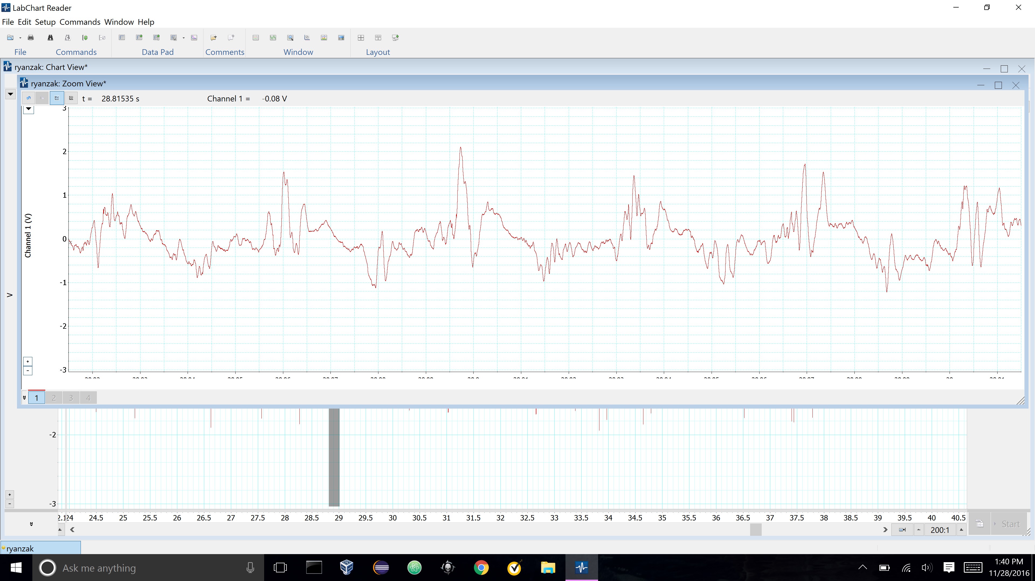
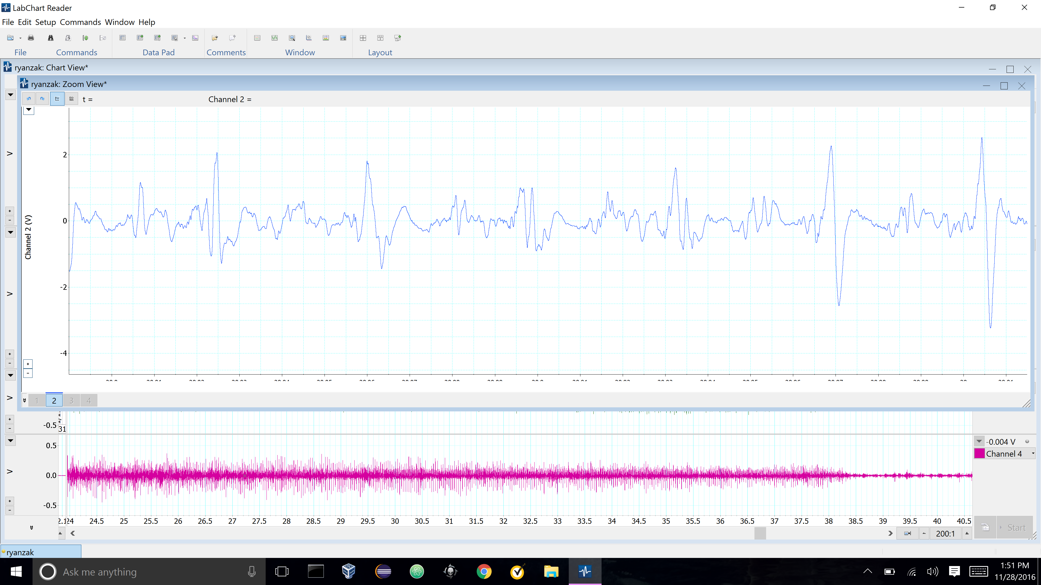
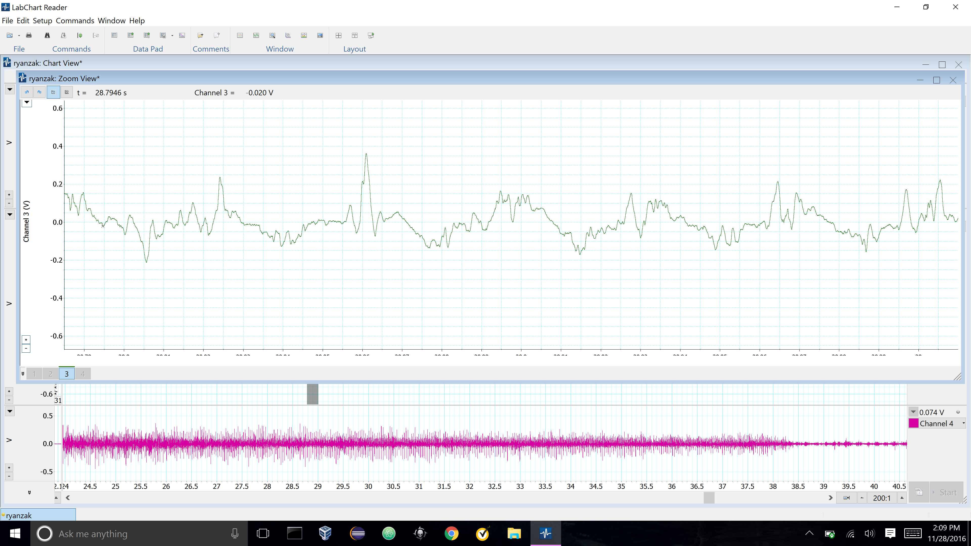
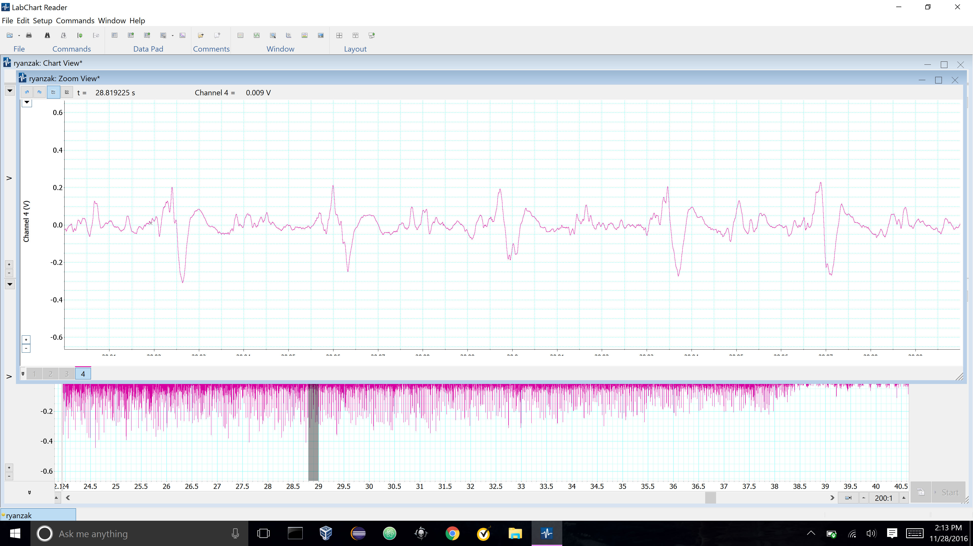
Cockroach Flight Pattern EMG After Ingestions of One drop of 1/11 Parts EtOH
Figure 3a – Flight of Cockroach After Administration of 1 drop EtOH.
The EMG recording here depicts the activity of all wings on the cockroach over the course of about 0.2 s after the cockroach ingested 1.0 drop of 1/11 parts EtOH. The red EMG represents the anterior left wing, the blue represents the anterior right, the green represent posterior left wing, and the pink represents the posterior right wing. The blue arrows show points of interest which likely depict beating of the wings.
28.8 28.9 29.0
Time (s)

Slide 10
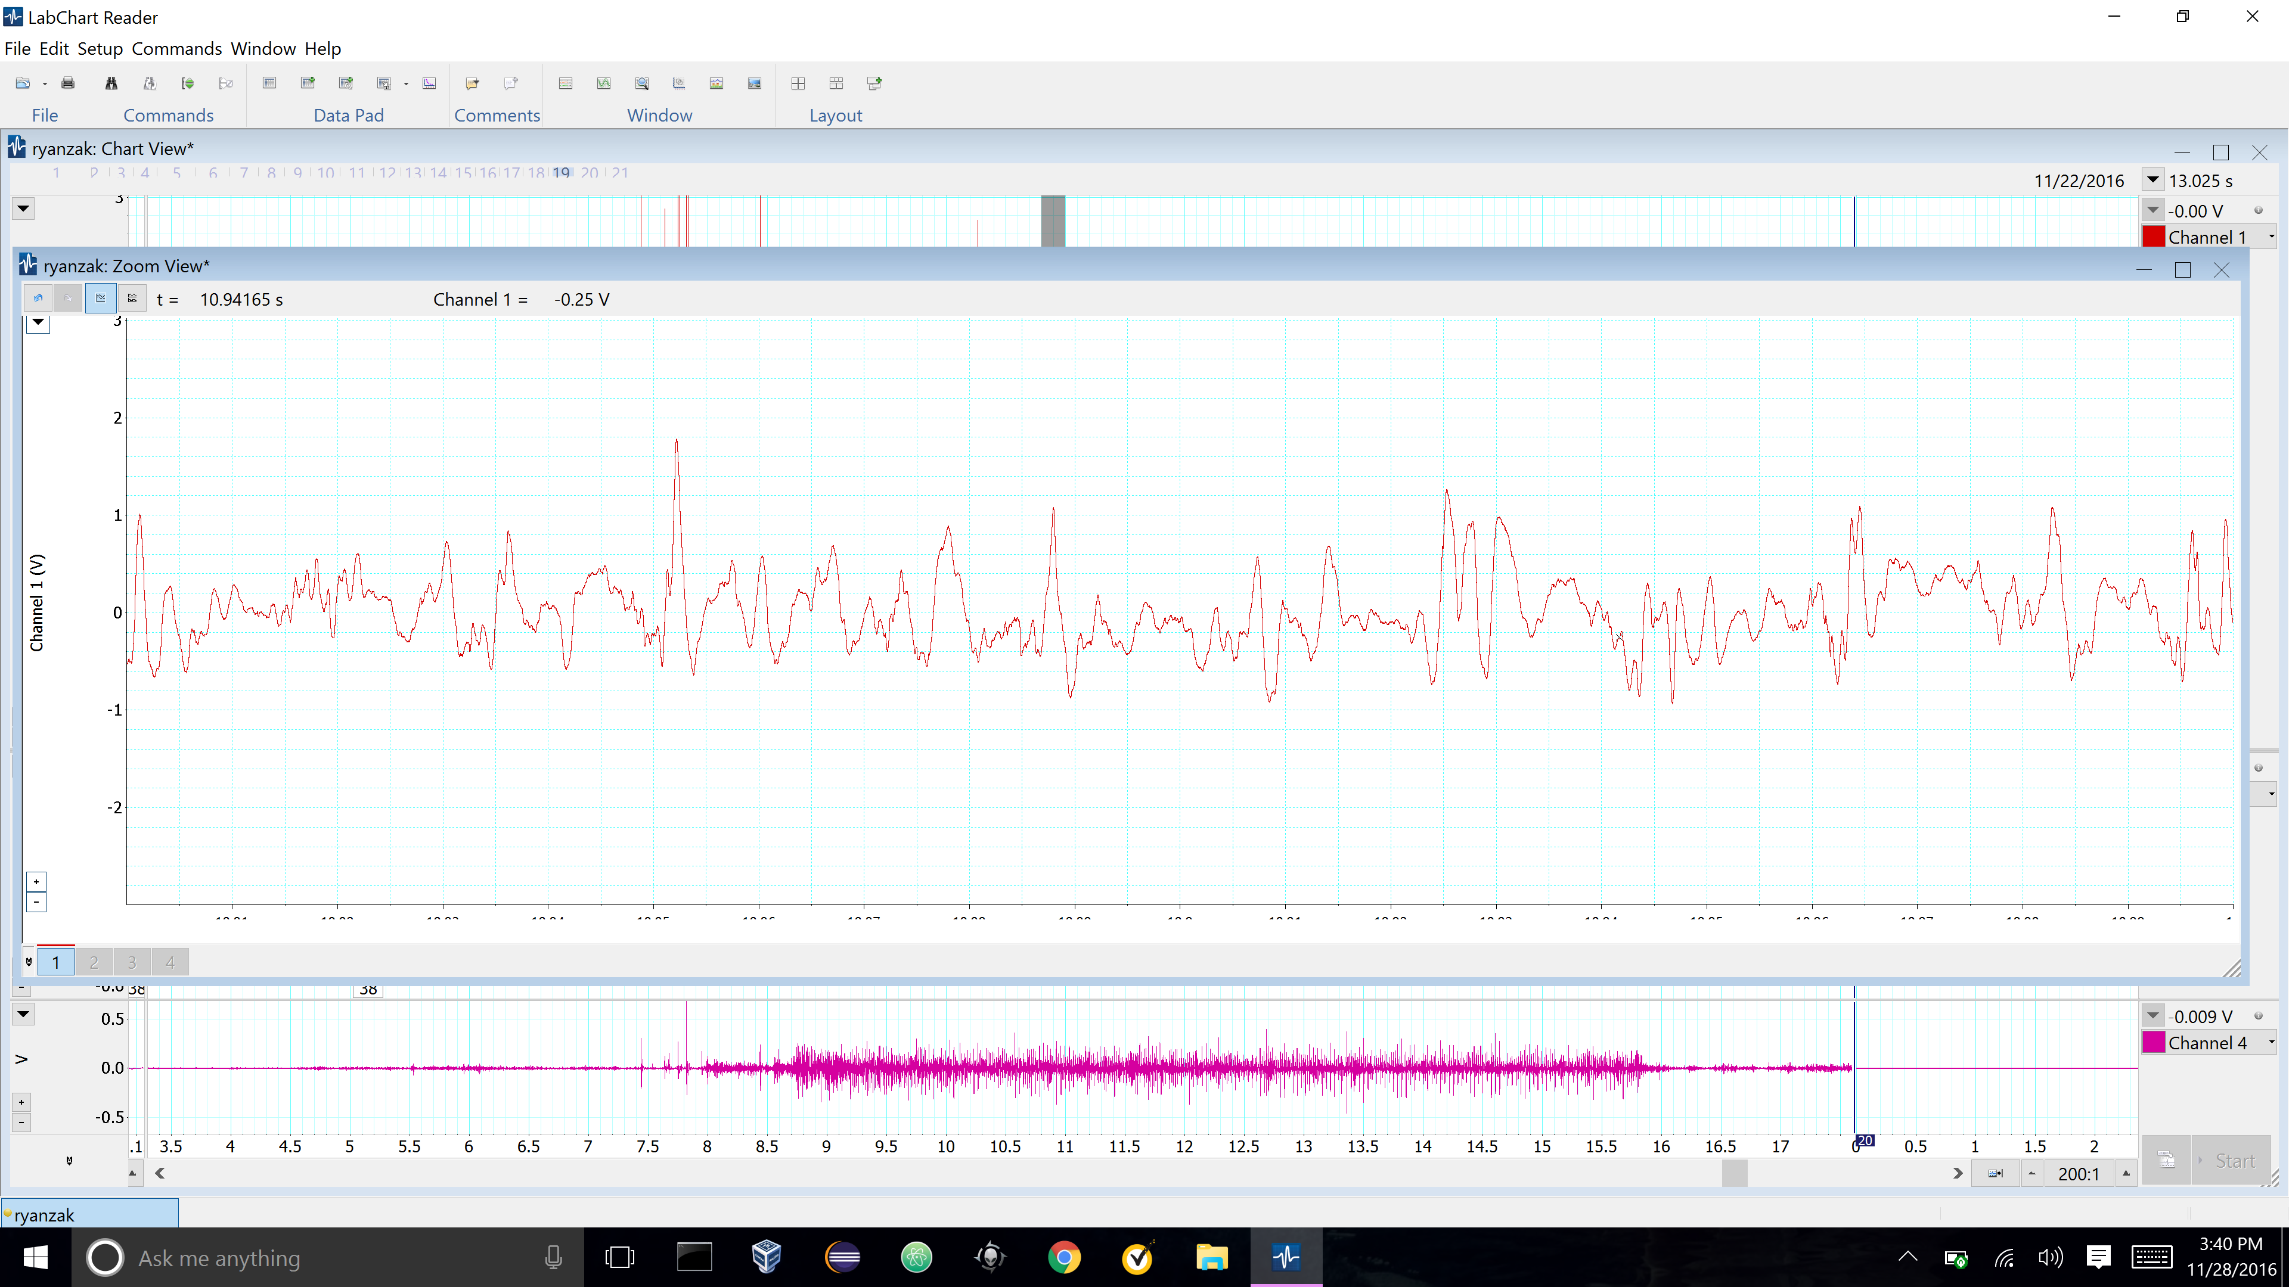
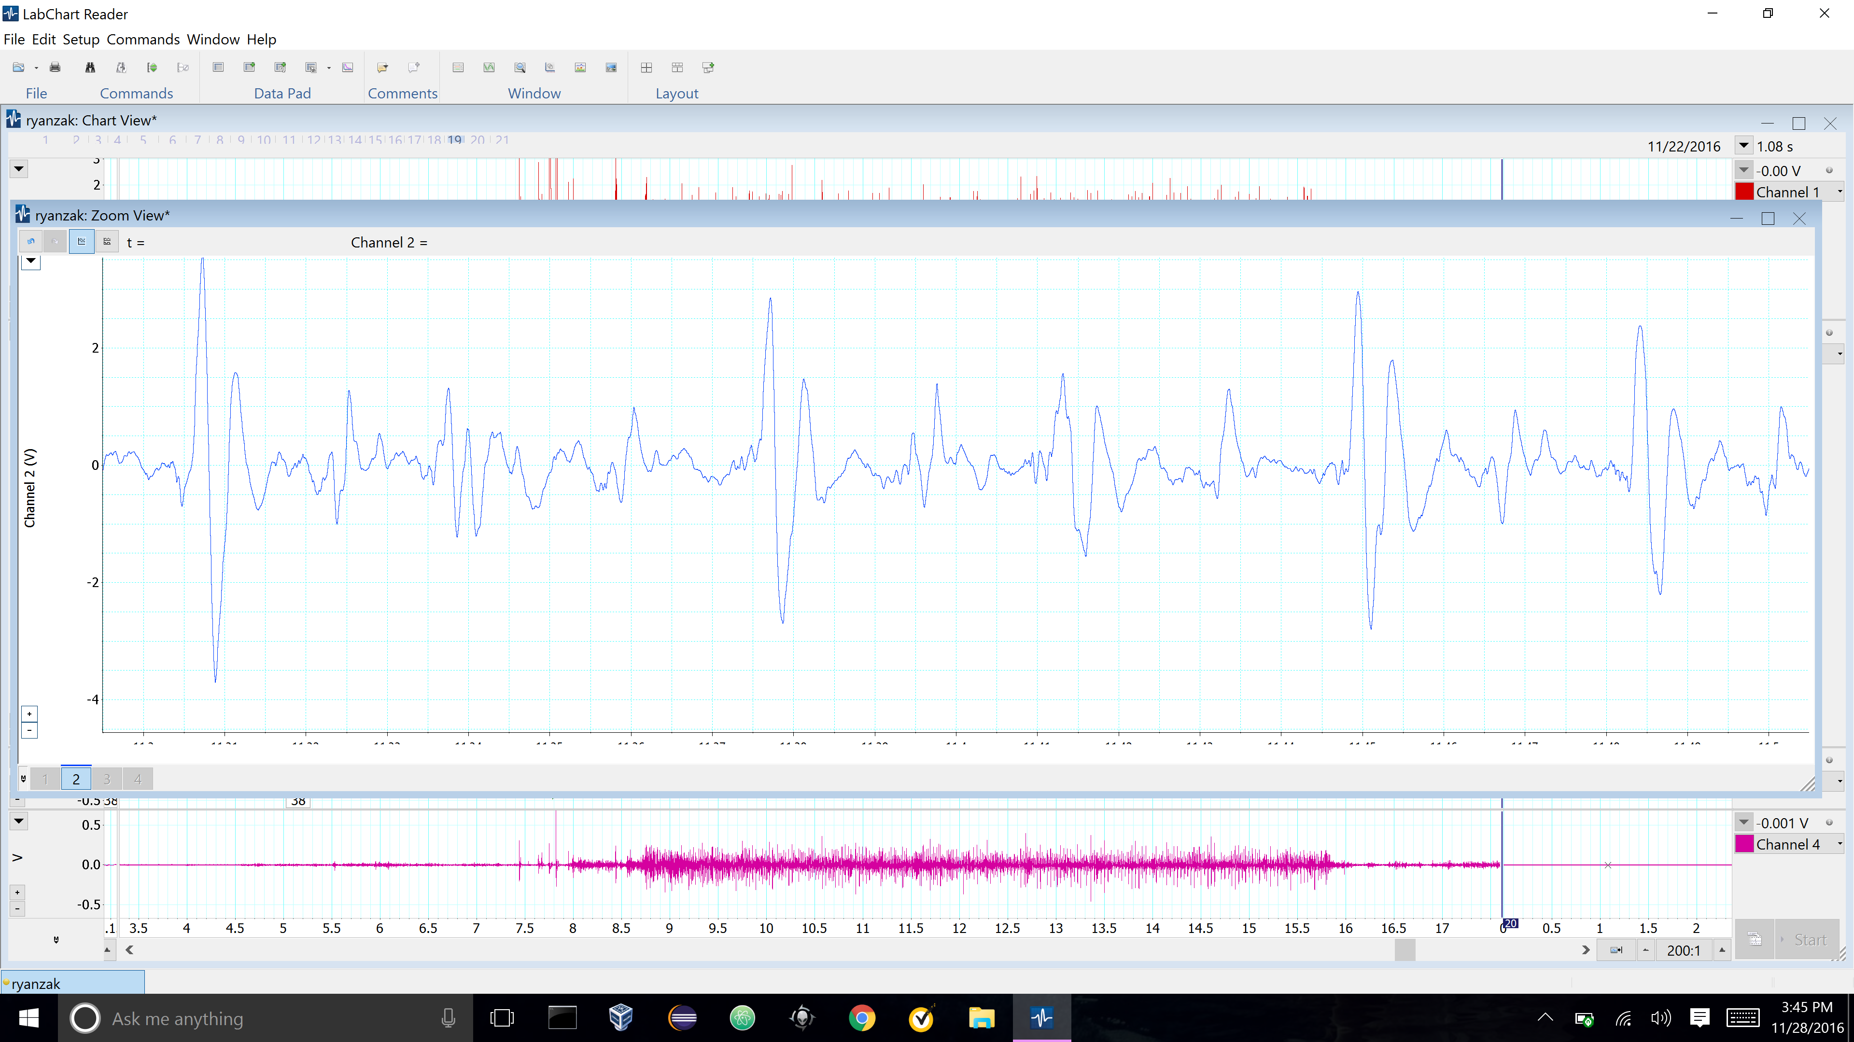
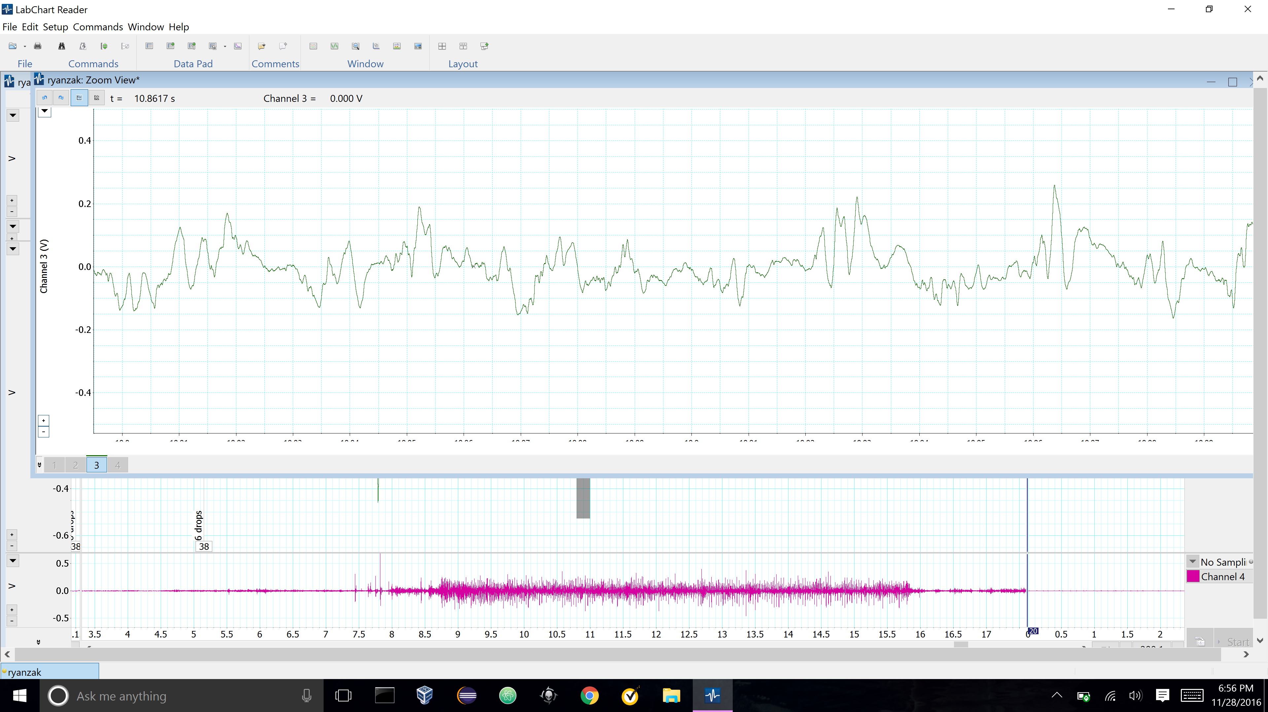
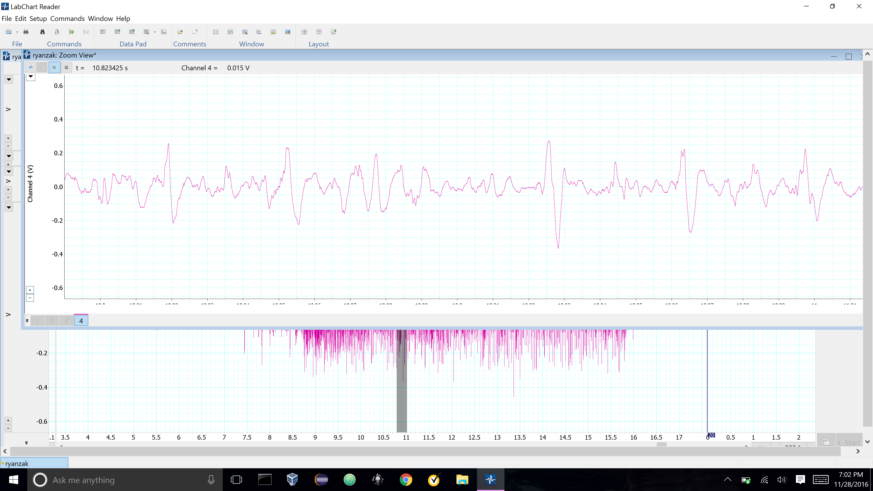
Cockroach Flight Pattern EMG After Ingestion of six drops of 1/11 Parts EtOH
Figure 3a – Flight of Cockroach After Administration of 6 drops EtOH.
The EMG recording here depicts the activity of all wings on the cockroach over the course of about 0.2 s after the cockroach ingested 6.0 drops of 1/11 parts EtOH. The red EMG represents the anterior left wing, the blue represents the anterior right, the green represent posterior left wing, and the pink represents the posterior right wing. The blue arrows show points of interest which likely depict beating of the wings.
28.8 28.9 29.0
Time (s)

